Slide 1
Process Management
System & Network Administration

Slide 2
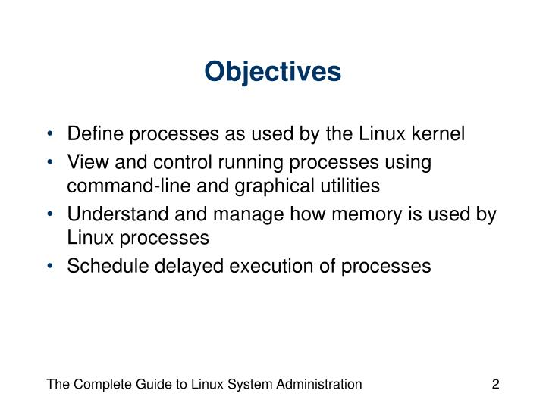

Slide 3
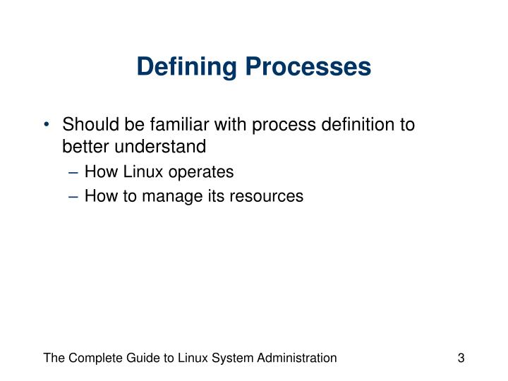

Slide 4
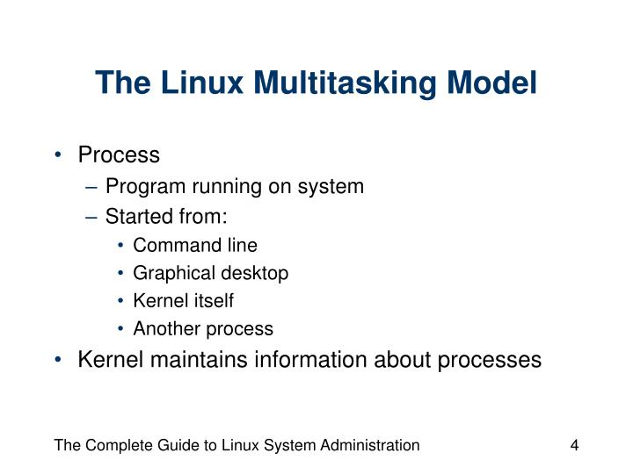

Slide 5
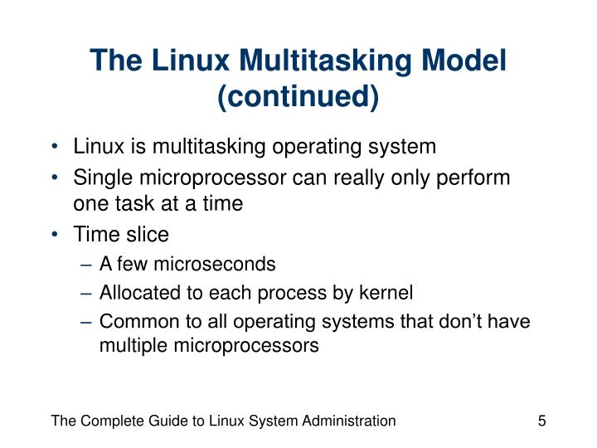

Slide 6
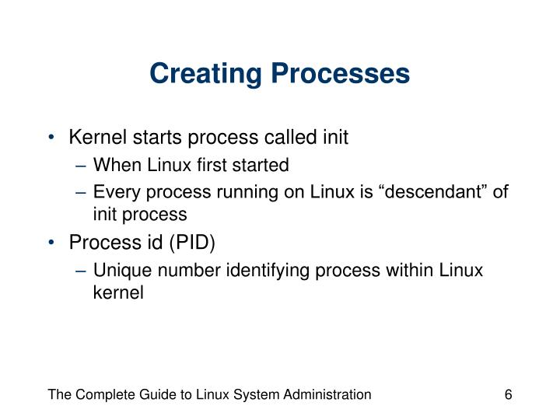

Slide 7
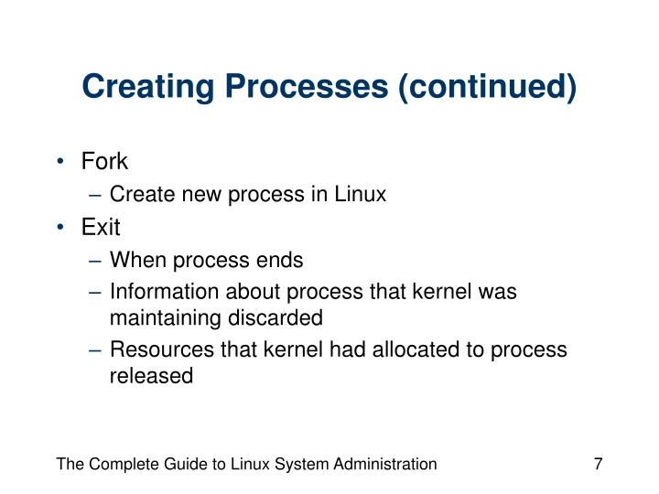

Slide 8
Types of Processes:
Foreground Processes:
They run on the screen and need input from the user. For example Office Programs
Background Processes:
They run in the background and usually do not need user input.
For example Antivirus.

Slide 9
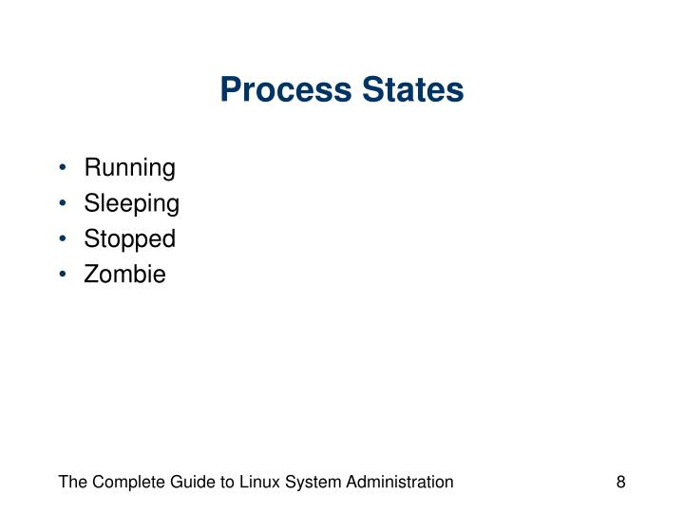

Slide 10
When the CPU executes a process, it will be in a RUNNING state. When the process is not waiting for any resource and ready to be executed by the CPU, it will be in the RUNNABLE state.
SLEEPING state indicates the process is currently waiting on certain resources (like waiting on I/O, waiting on locks, application code making the process to sleep.
STOPPED state indicates that the process has been suspended from proceeding further. In Linux when you issue the ‘Ctrl + Z’ command it will issue a SIGSTOP signal to the process.
A process will terminate when it calls ‘system exit’ API or when someone else kills the process. When a process terminates, it will release all the data structures and the resources it holds. However, it will not release its slot in the ‘process’ table. Instead, the process will send a SIGCHLD signal to its parent process. Now it’s up to the parent process to release the child process slot in the ‘process’ table. The process will be in ZOMBIE state from the time the child process issues the SIGCHLD signal until the parent process releases the slot in the ‘process’ table.

Slide 11
Command Description
bg To send a process to the background
fg To run a stopped process in the foreground
top Details on all Active Processes
ps Give the status of processes running for a user
ps PID Gives the status of a particular process
pidof Gives the Process ID (PID) of a process
kill PID Kills a process
nice Starts a process with a given priority
renice Changes priority of an already running process
df Gives free hard disk space on your system
free Gives free RAM on your system

